Slide 1
D.3 Encryption Methods– Apr 30
Agenda
Module D.3 Encryption Methods
Discussion: Morse Code
Complete Module D.3 Today
Upcoming
Tomorrow: Programming – Encryption Coding

Slide 2
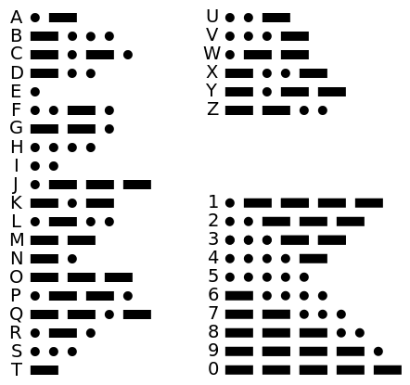
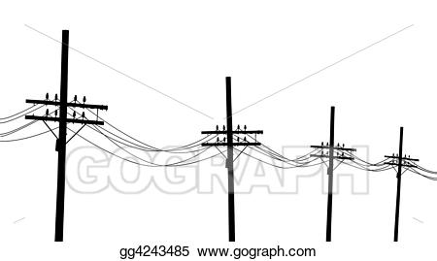
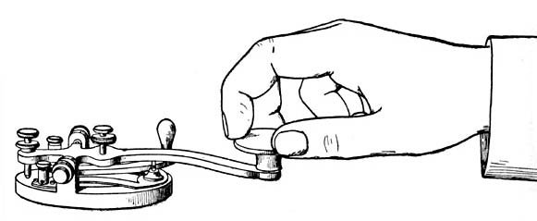
Morse Code
Decode The following Message:
0000 0 0100 0100 111 011 111 010 0100 100

Slide 3
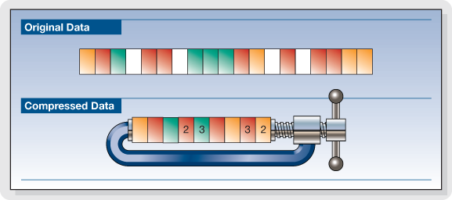
Morse Code
Encoding Efficiency
Variable length Encoding
Most common letters / words
Have shorter codes

Slide 4
Simple Encryption – Binary Addition
Encryption
Decryption
Original Message: | 1 | 1 | 1 | 0 | 0 | 1 | 0 | 1 | 0 | 1
Key: | 1 | 1 | 0 | 0 | 1 | 0 | 1 | 0 | 0 | 1
Encrypted Message: | 0 | 0 | 1 | 0 | 1 | 1 | 1 | 1 | 0 | 0
Encrypted Message: | 0 | 0 | 1 | 0 | 1 | 1 | 1 | 1 | 0 | 0
Key: | 1 | 1 | 0 | 0 | 1 | 0 | 1 | 0 | 0 | 1
Original Message: | 1 | 1 | 1 | 0 | 0 | 1 | 0 | 1 | 0 | 1

